Slide 1

Vision Programming for Intelligent Autonomous Robot Using ROS
Ir Dr zool hilmi Ismail & INNOKAI TEAM

Slide 2
OUR SCHEDULE
Session 1 : Revision and Simple Command on Linux
Quick Flashback on Phase 1
Session 3: Revise back about OpenCV
Task Given, Creating package, workspace
Revise back some useful command in Linux
Detecting Edges and Applying Image Filters
Session 2: Revise back about Python
Revise back basic of python
Some exercises to test programming skills
Blurring
Edge detection
Converting between different color spaces
# DAY 1

Slide 3
OUR SCHEDULE
Session 4: Continue OpenCV
Motion blur
Session 6: : Labelling and Training model
Do the labelling
Session 5: Installation of YOLO
Introduction to YOLO Bbox Annotation Tool
Object Tracking
Installation the Tool on LinuxOS (Laptop)
Sharpening
Embossing
Train the model by using Laptop
# DAY 2

Slide 4
OUR SCHEDULE
Session 7: Programming with ROS
Follow-bot
Hands-on on the TurtleBot3
# DAY 3

Slide 5
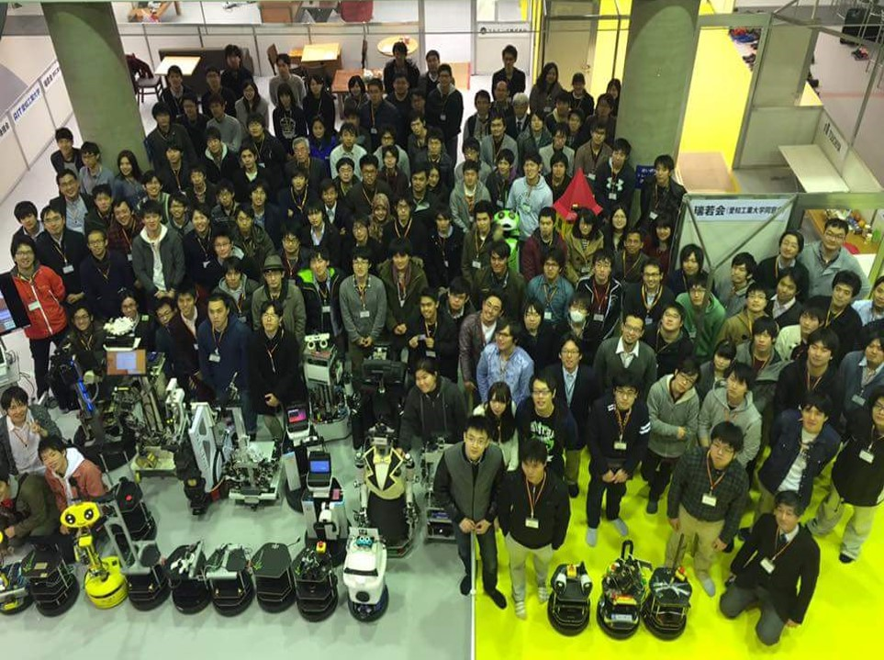
LET'S START CODING… SESSION 1

Slide 6
Task
Create a workspace in home
Workspace name is innokai_opencv_ws
Create a package with stds_msgs, rospy and roscpp
Package must be ros_basic

Slide 7
Getting into Linux

Slide 8
Installation of packages and libraries
From Github
Git clone into src folder in workspace

Slide 9
Revise back about Python
Session 2

Slide 10
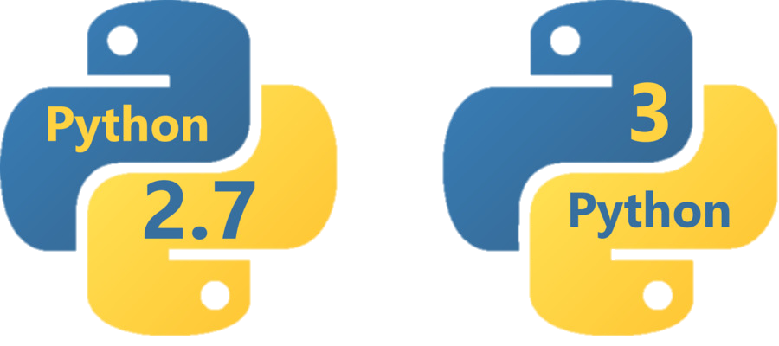

Slide 11
Basic of Programming
Pseudo Code
A simple description of a computer algorithms using a combination of natural language and programming language.
In other words, this is description of your code before you start coding
Flowchart
Flowcharts are written with program flow from the top of a page to the bottom

Slide 12
Basic of Python
Classes
Function
Variable
Loop
Mathematical operationn

Slide 13
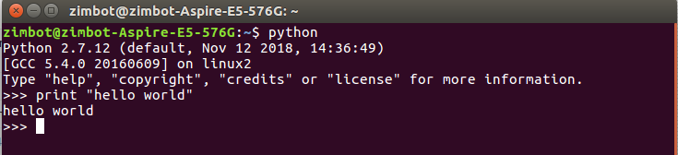
First Try in Python Programming
HELLO World

Slide 14
Types of Data
String
Char
Number
Float
Double
Int
Boolean

Slide 15
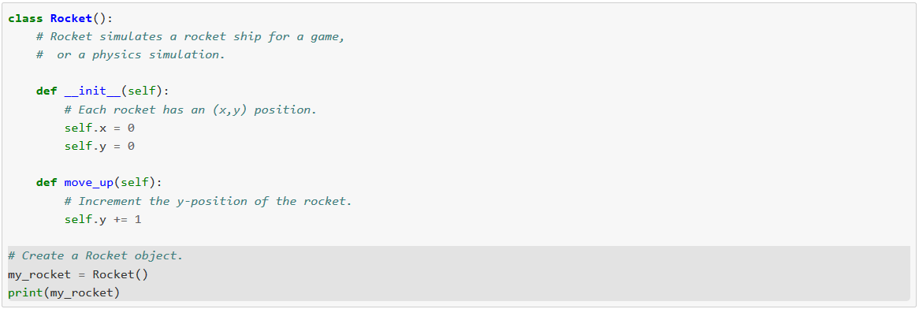
Class
Classes are a way of combining information and behavior.

Slide 16
Exercise
Use Class to create a simple calculator which can perform:
- Additional
- Subtraction

Slide 17
OpenCV

Slide 18
OpenCV
OpenCV is a library of programming functions mainly aimed at real-time computer vision
We may use OpenCV without ROS.
In this workshop, we will discuss about the usage of OpenCV
Notes:
18

Slide 19
Revision to OpenCV
Resizing images
>> resized = cv2.resize(image, (200, 200))
Resizing in ratio
Using imutils
In a new terminal to install imutils
>> pip install imutils --user
Notes:
19

Slide 20
Rotating an image
>> rotated = imutils.rotate(image, -45)
Rotate without clipping
>> rotated = imutils.rotate_bound(image, 45)
Smoothing an image
>> blurred = cv2.GaussianBlur(image, (11, 11), 0)
Notes:
20

Slide 21
Detecting Edges and Image Filtering
Session 3

Slide 22
In this session, we are going to see
How to blur an image
How to detect edges in an image
How to apply motion blur to an image
How to sharpen an image
How to erode and dilate an image
How to create a vignette filter
How to enhance image contrast

Slide 23
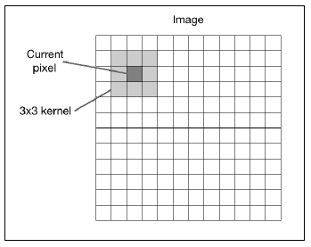
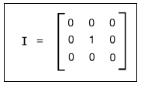
2D convolution
Convolution is a fundamental operation in image processing.
Kernel = matrix.
Here, the kernel is called the "image filter" and the process of applying this kernel to the given image is called "image filtering".

Slide 24
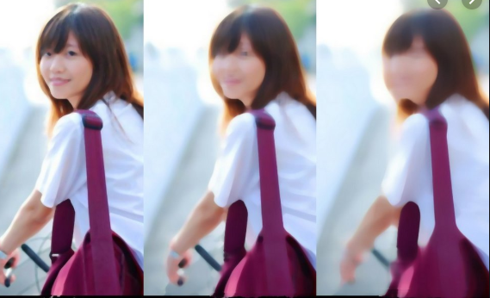
Blurring
This is also called a low pass filter.
Several ways to blur an image
Averaging
blur = cv.blur(img,(5,5))
Gaussian Blurring
blur = cv.GaussianBlur(img,(5,5),0)
Median Blurring
median = cv.medianBlur(img,5)
Bilateral Filtering
blur = cv.bilateralFilter(img,9,75,75)
blur(simple average)
medianBlur
GaussianBlur()

Slide 25
Converting between different color spaces

Slide 26
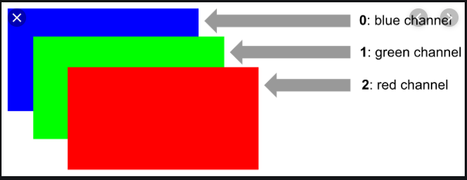
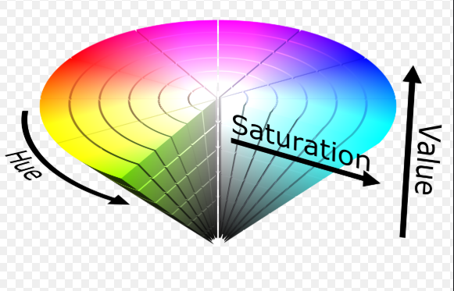
In general, three color spaces are prevalent in modern day computer vision: gray, BGR, and Hue, Saturation, Value (HSV).
Gray :
eliminates color information translating to shades of gray:
useful for intermediate processing, such as face detection.
BGR : blue-green-red color space
each pixel is a three-element array
web developers would be familiar with a similar definition of colors, except the order of colors is RGB.
HSV :
hue is a color tone, saturation is the intensity of a color, and value represents its darkness (or brightness at the opposite end of the spectrum).

Slide 27
COLOR CALCULATOR
Click link to open the website
https://www.tydac.ch/color/

